Slide 1

Smart Resume Analyzer
AL23421 – Machine Learning Laboratory | Semester IV | 2025–2026
JANISE DEEPTHI Y P
2117240070124
DEPT. OF AI & DS

Slide 2

The Problem
Inefficient
Prone to Bias
Manual screening is time-consuming at scale
Human judgment introduces inconsistency
Hard to Scale
Recruiters can't quickly verify required skills

Slide 3
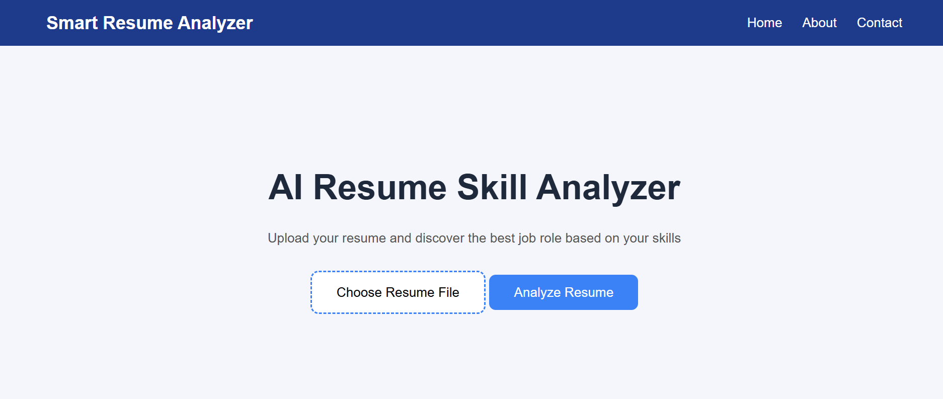
Project Goals
Extract Skills
Automatically parse resumes using NLP
Match to Job Roles
Compare against predefined skill sets
Calculate Match Score
Return a percentage match
Recommend Missing Skills
Help candidates improve profiles

Slide 4
Theoretical Background
NLP
Text Preprocessing
Enables machines to understand & process human language
Lowercasing, removing punctuation, tokenization
Skill Extraction
Skill Matching
Match resume words against predefined skill dataset
Rule-based comparison: Match Score = |A ∩ B| / |B| × 100

Slide 5
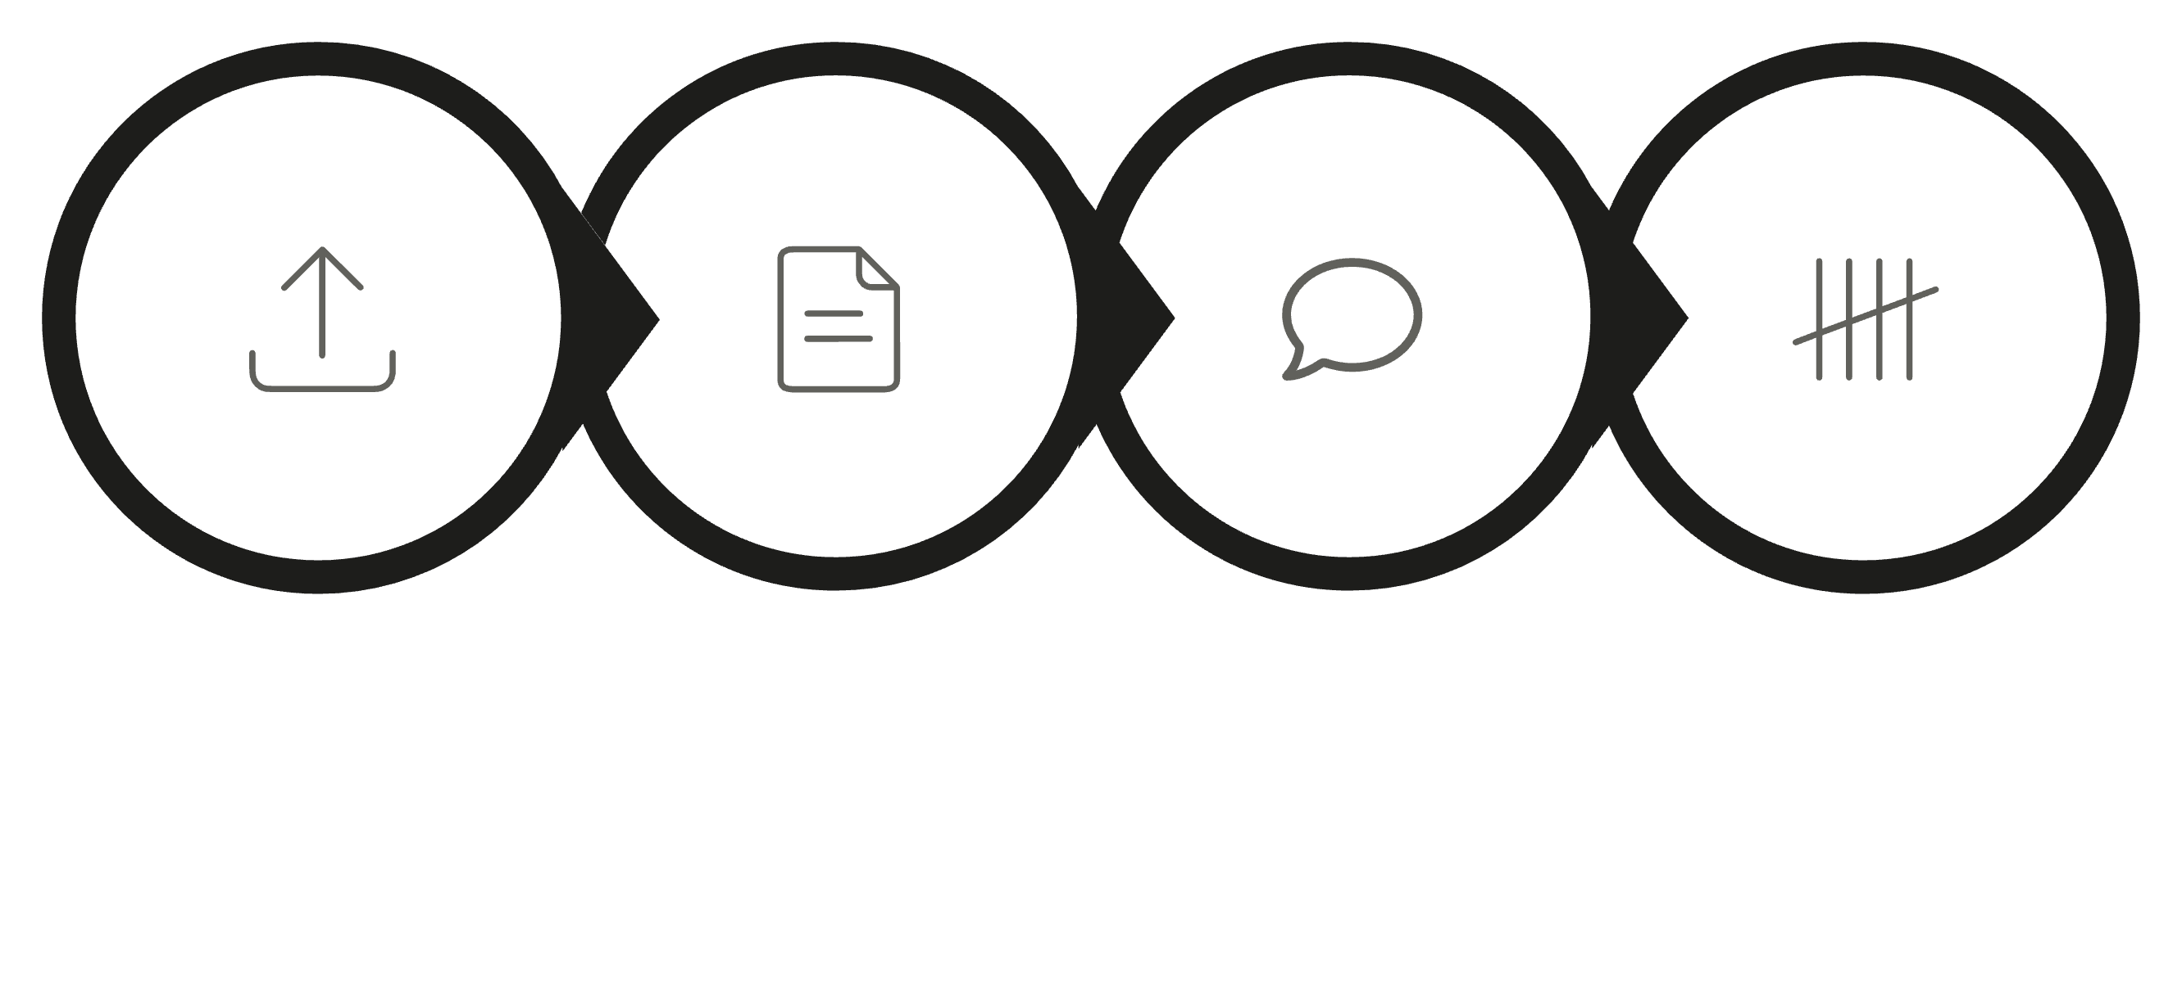
System Architecture
Upload Resume
Parse & Preprocess
Extract Skills
Match & Score
End-to-end flow from resume upload through NLP processing to skill match scoring.

Slide 6
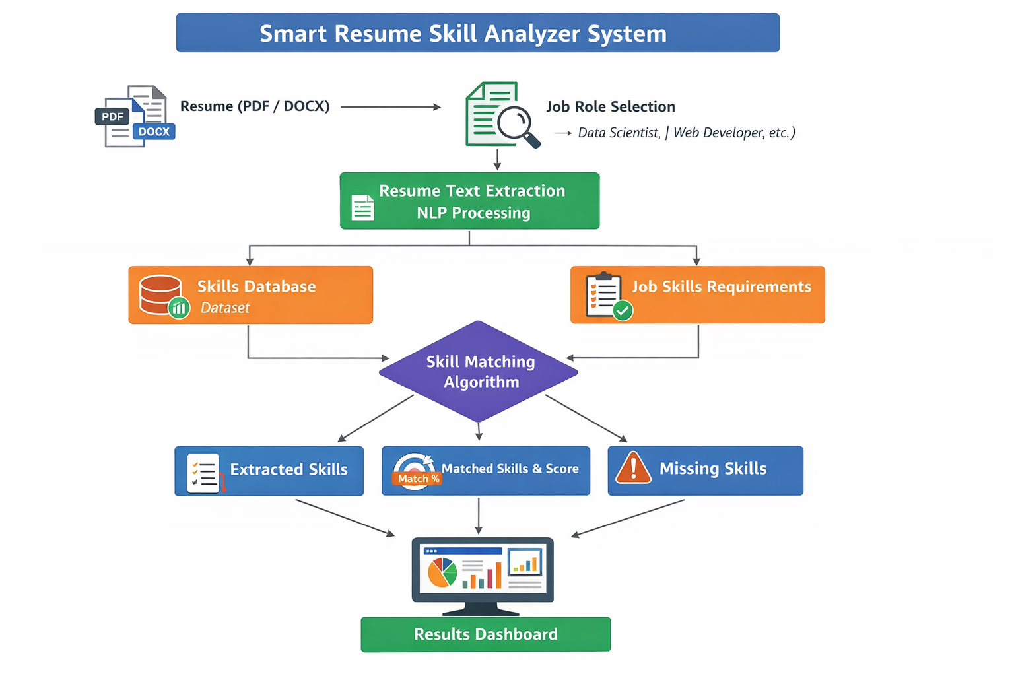
Algorithm in Action
Example: Data Scientist Role
Resume Skills
Required Skills
Python, SQL, Machine Learning
Python, SQL, ML, Deep Learning
Matched
Missing
Python, SQL, ML
Deep Learning
Score
75%

Slide 7
Implementation
Tech Stack
Dataset
~25 skills, custom-created, text-based, public license
Flask
Python
Modules
NLP
PDF/DOCX
app.py – Flask server & routes
resume_parser.py – PDF/DOCX text extraction
skills.py – Skill extraction from text
model.py – Match & score calculation

Slide 8
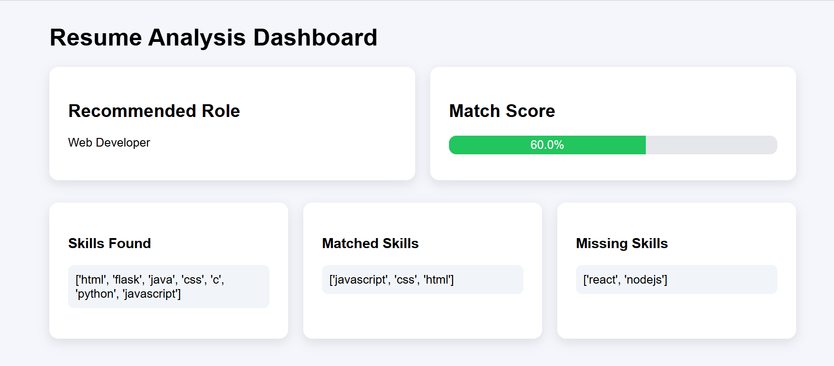
Live Output
Recommended Role
Web Developer
Match Score
60%
Matched Skills
JavaScript, CSS, HTML
Missing Skills
React, NodeJS

Slide 9


Results & Future Scope
✅ Achieved
Extracts skills, calculates match %, identifies gaps
🔭 Future
TF-IDF/BERT models, resume ranking, React frontend, recruiter dashboard
GitHub: github.com/JaniseDeepthi/MachineLearning-Miniproject

